Slide 1


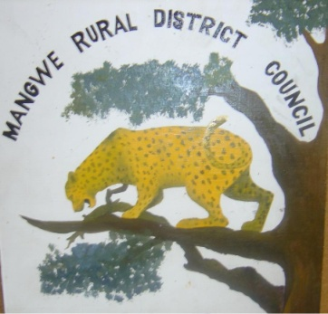
MANGWE RURAL DISTRICT COUNCIL
INVESTMENT PROSPECTUS

Slide 2
INDICATOR /ATTRIBUTE | VALUE/ DESCRIPTION
Country / Province | Zimbabwe, Matabeleland South
Number of constituencies | 2 constituencies Mangwe Constituency Matobo Mangwe constituency
Land area/ Coverage | 545,937 hectares/ 5,962km²
Number of wards | 17
Number of villages | 83
Number of households (2022 census) | 16,390
Total Population (2022 census) | 65,562 31 067 Males & 34 495 Females Women make up 52.6% Men make up 47.4% Youth make up 42%
Climate /agro-ecological zone | dry, semi arid: Agro ecological region
Number of educational facilities | 47 Primary, 15 Secondary, 1 vocational centre
Number of health centres | 15

Slide 3
MANGWE OVERVIEW
INDICATOR /ATTRIBUTE | VALUE/ DESCRIPTION
Hydrology | 5 major rivers namely Ingwizi Embakwe Sanzukwi Simukwe Ramokgwebane 4 major dams namely Mangwe Ingwizi Mhlanga Shashi
Primary Economic Activity | Livestock production, small grain production
Number of Business centres | 103 business centres
Districts sharing borders | Bulilima District to the North Matobo District to the East Botswana to the South East
Number of Business centres | 103 business centres
Districts sharing borders | Bulilima District to the North Matobo District to the East Botswana to the South East

Slide 4
WHY invest in mangwe district
There are two strategic centres in Mangwe, Ingwizi G/P and Mphoengs RSC with numerous benefits
The size and strategic location of Ingwizi Growth Point makes it a hub for economic growth and development in Mangwe District as it is located at the heart of the district.
Ingwizi's population is increasing, driving demand for services and creating opportunities for businesses.
Mphoengs offers tremendous growth potential, with 65 residential stands and a commercial centre, providing room for expansion.
It boasts unbeatable accessibility, situated less than 25km from Francis Town, Botswana. This strategic location serves as a gateway between Zimbabwe and Botswana, unlocking regional trade opportunities and positioning Mphoengs as a hub for cross-border business and investment for a growing market.

Slide 5
DISTRICT ENDOWMENTS & INVESTMENT OPPORTUNITIES
TOURISM
MINING
LIVESTOCK
AGRICULTURE
LAND DEVELOPMENT
SOLAR POWER GENERATION
WIND POWER GENERATION

Slide 6
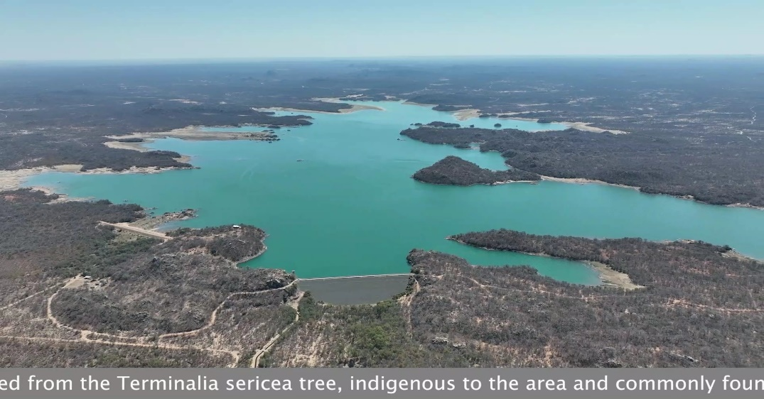
INGWIZI DAM

Slide 7
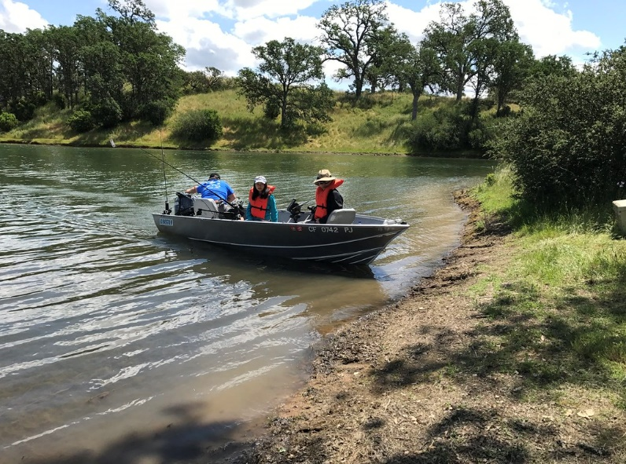
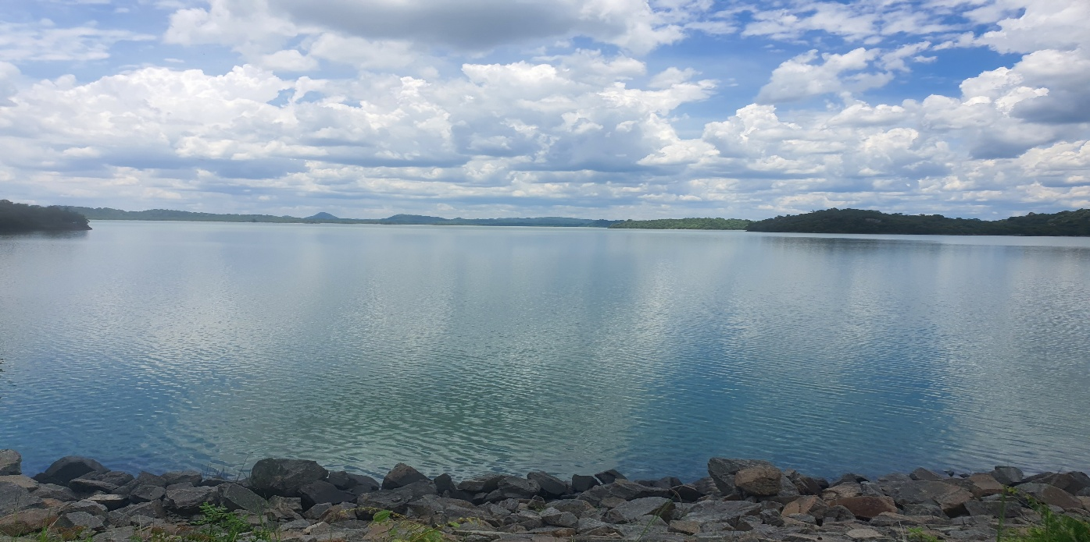
INGWIZI DAM FISHING AND BOATING
As you stand on its shores, you are greeted by the sight of rolling hills, lush vegetation, and the shimmering surface of the water, all of which create a picturesque backdrop for a variety of outdoor activities.
With its vast waters, you can find numerous fishing spots that cater to different preferences and skill levels. Whether you are casting your line from a boat or the shore, the thrill of reeling in a catch amidst such natural beauty is an experience like no other. As you embark on your fishing journey, you will discover not only the joy of angling but also the serenity that comes from being surrounded by nature’s wonders.

Slide 8
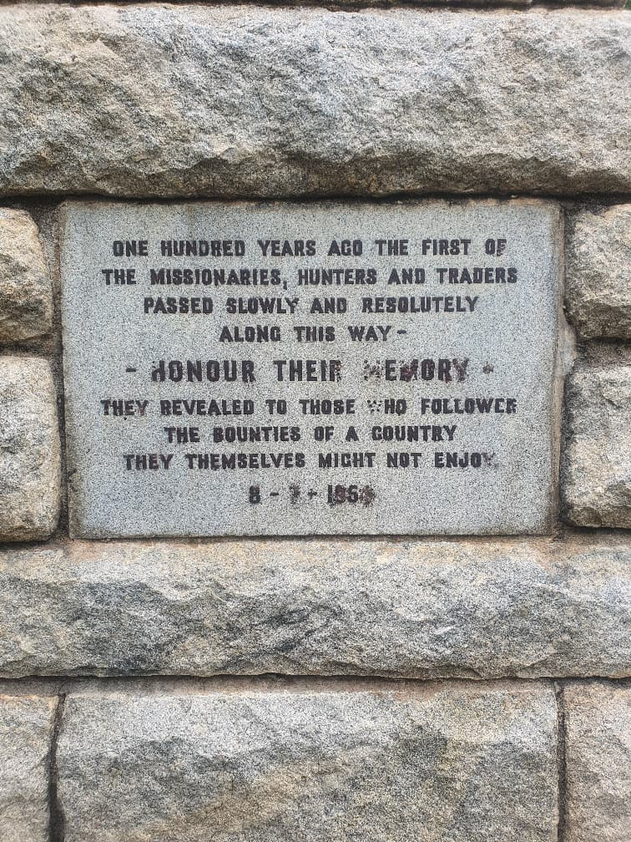
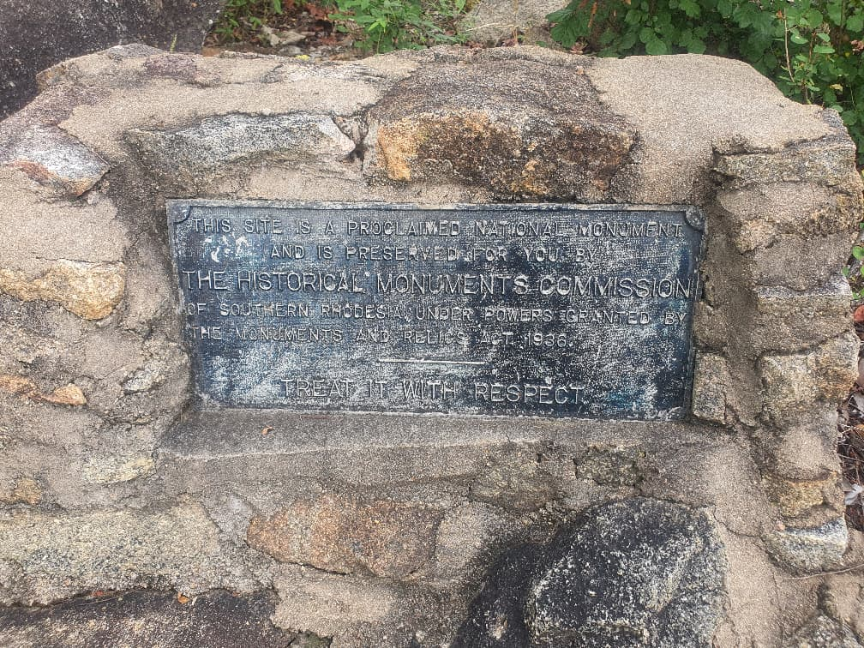
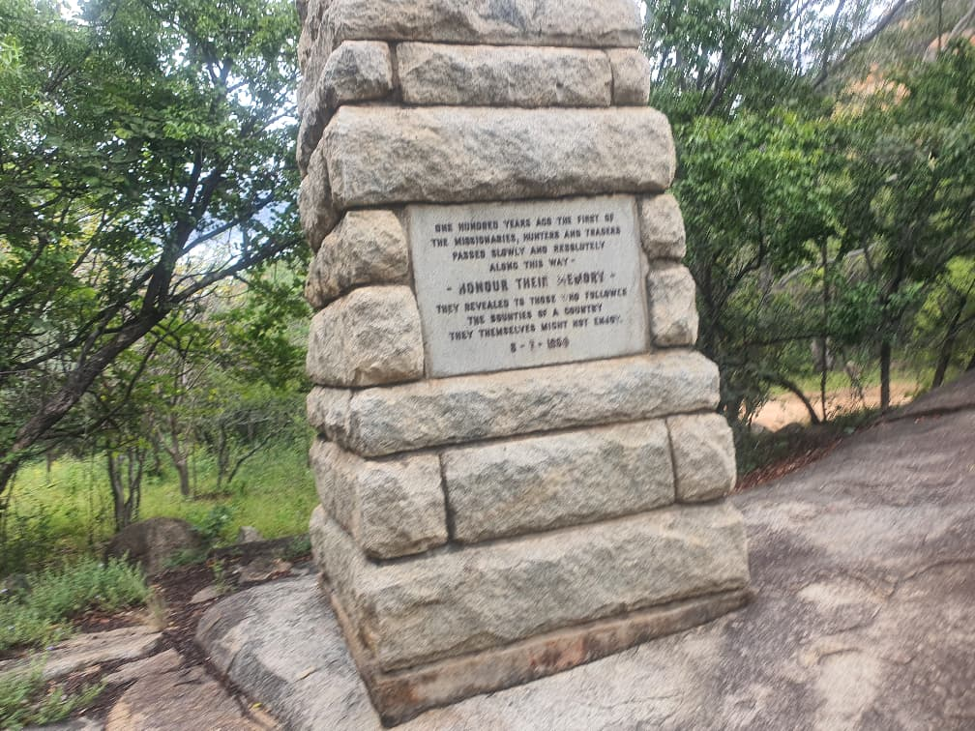
Mangwe Pass, the Historical Monument in Mangwe District.
The Mangwe Pass Memorial to the Pre-Pioneers was unveiled on July 18, 1954, by Sir Robert Tredgold. a great-grandson of Robert Moffat who was one of the first Europeans to enter the pass.

Slide 9
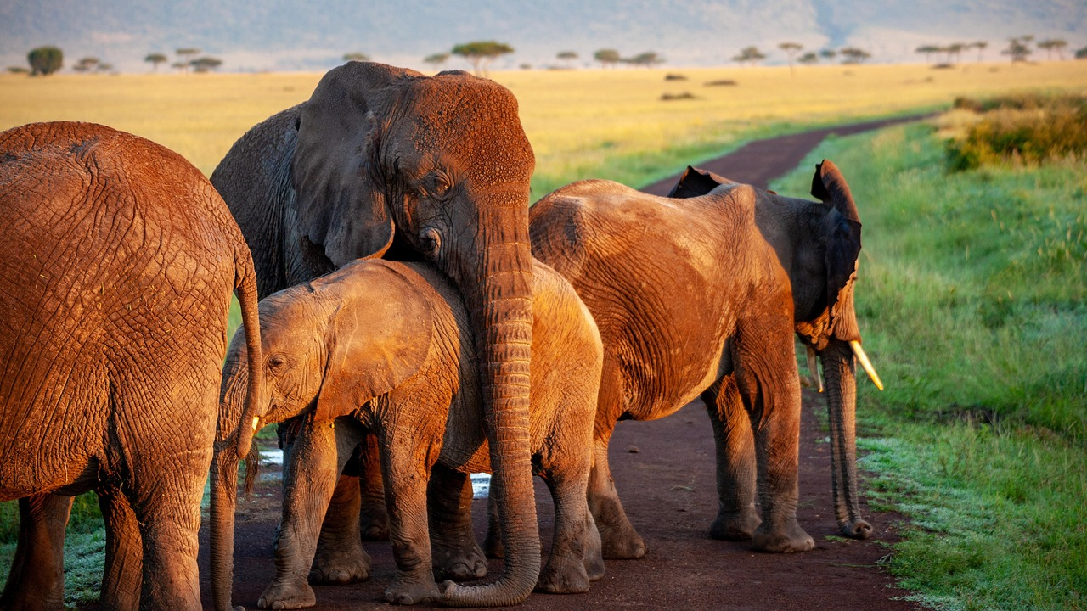
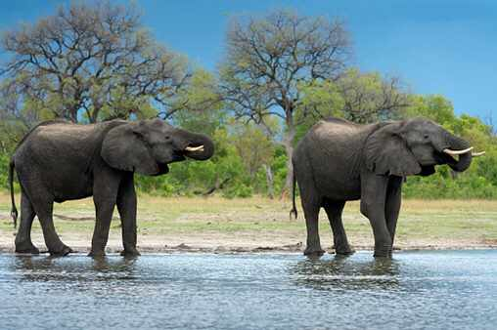
ELEPHANT HERD
These elephants primarily spend their time in family groups, varying in size from 3 to 10 individuals. Composed mainly of closely related female elephants, these groups are led by a dominant matriarch, usually the oldest and most experienced female. The matriarch guides the family to crucial resources, including vegetation, water from Ngwizi dam, and essential mineral deposits around the area.

Slide 10
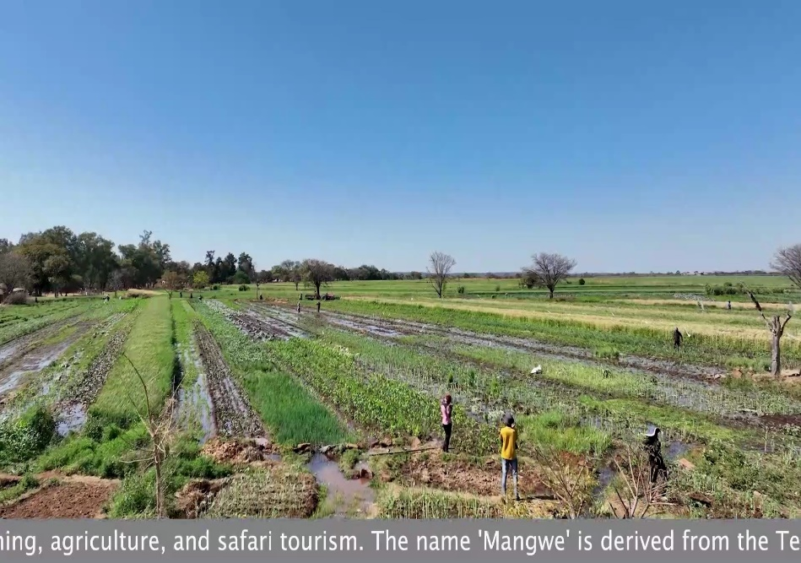
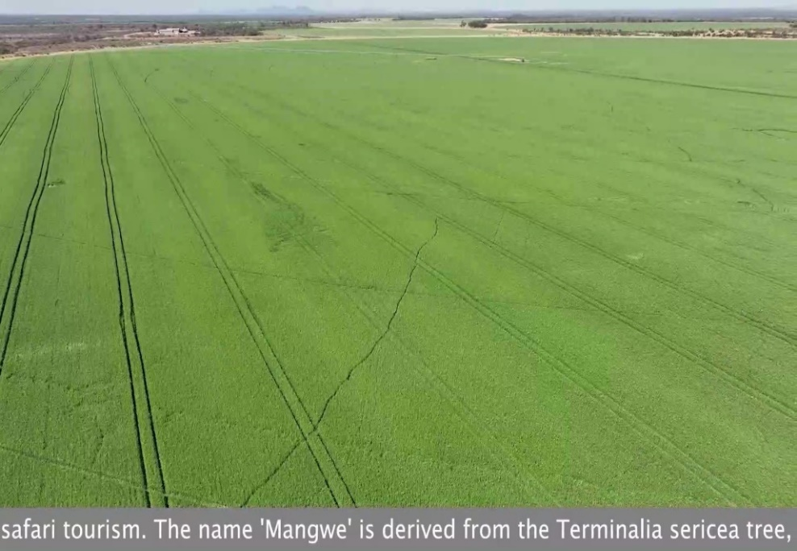
INGWIZI ARDA IRRIGATION
ARDA Ingwizi Estate in Mangwe, are already in full swing, buoyed by recent rehabilitation of key irrigation schemes such as Midlo and Masholomoshe under the Green Climate Fund programme. The estate also has 22 hectares of sugar beans at maturity stage, 120 hectares of commercial maize approaching harvest, 132 hectares of hybrid maize, and 45 hectares of potatoes ready for lifting.
Performance of newly rehabilitated irrigation schemes and highlighted the growing participation of individual farmers in wheat cultivation. More schemes like Midlo and Masholomoshe are now back in production, and individual farmers are also playing a vital role this season

Slide 11
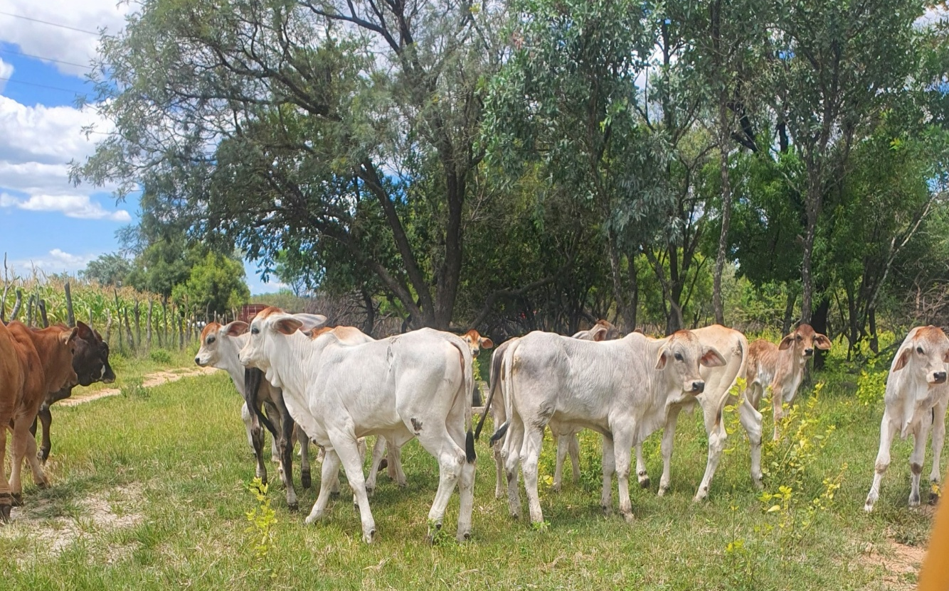
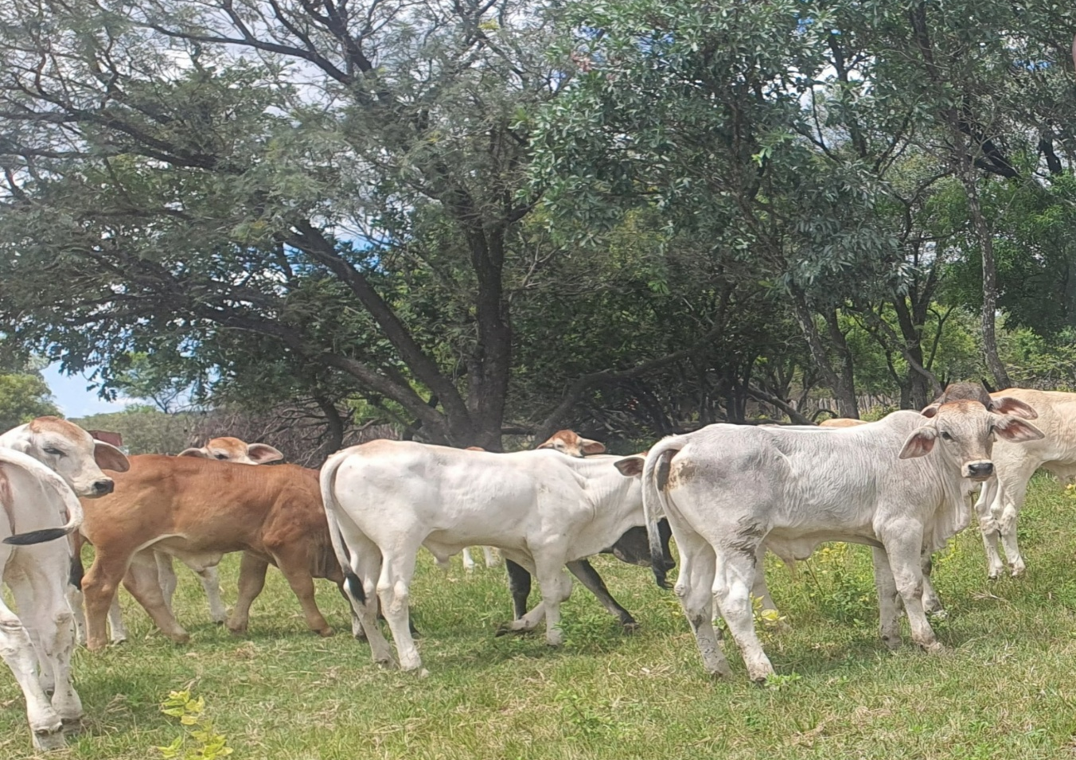
LIVESTOCK RANCHING
Mangwe is a livestock ranching district, producing quality meat all year round and garnering interest from other districts. Cattle ranching, goat production and sheep production are viable projects for pursuit.

Slide 12
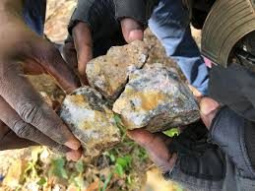

MINING
Mangwe houses a lot of mining activities, with its land rich in minerals such as gold and lithium.

Slide 13
MASTER PLAN POTENTIAL INVESTMENTS
Potential Investments | No.
Irrigation Schemes | 3 (Maninji, Ingwizi, Empandeni)
Conservancy | 2 (Marula, Lower Shashe)
Truck In | 2 (Marula, Ramokgwebane)
Centres marked for residential growth | 4 (Marula, Nxele, Brunapeg, Madabe, Mhlotshana)
Dams | 2 (Empandeni, Maninji)
Tourism Corridor | 1 (Ingwizi)

Slide 14
SECTOR 1:
TOURISM

Slide 15
Project Title | Ingwizi Dam Resort Centre
Project Promoter and Contacts | Mangwe Rural District Council Contact: Mrs. G. Khupe-Sibindi – District Engineer – +263772829236 Contact: Mr. I. Moyo – District Spatial Planner – +263779685525 Contact: Mr. X. Moyo – District Natural Resources & Conservation Officer – +263772478530
Location | Ingwizi Dam, Mangwe District, Matabeleland South, Zimbabwe
Investment Type/Financing Model | PPP, Government Grants/Tourism Development Funds Council has uninhabited land with diverse wildlife resources and there is plan to establish a wildlife conservancy for consumptive and non-consumptive tourism.
Project Scope | Establishment of a resort centre around Ingwizi Dam through the construction of lodge and conferencing facilities along the waterfront Establishment of outdoor camping sites and development of fishing activities revenue generation. Tourist attraction facility
Estimated Project Overall Cost | ~US$2,000,000
Project Status | Greenfield
Feasibility Studies done or Business Plan | Costing estimates and engagement of potential investors
Expected Benefits | Tourism promotion Growth of local businesses Job creation Infrastructure development

Slide 16
Project Title | Shashe Conservancy
Project Promoter and Contacts | Mangwe Rural District Council Contact: Mr. X. Moyo – District Natural Resources & Conservation Officer – +263772478530
Location | Lower Shashe, Ward 17 Makorokoro, Mangwe District, Matabeleland South, Zimbabwe
Investment Type/Financing Model | BOT. Council has uninhabited land with diverse wildlife resources and there is plan to establish a wildlife conservancy for consumptive and non-consumptive tourism.
Project Scope | Establishment of a 5500ha wildlife conservancy (Lower Shashe Conservancy)
Estimated Project Overall Cost | ~US$4,000,000
Project Status | Greenfield
Feasibility Studies done or Business Plan | Prefeasibility done
Expected Benefits | Tourism promotion Growth of local businesses Job creation Infrastructure development Environmental protection

Slide 17
SECTOR 2:
HOUSING DEVELOPMENT & Social amenities

Slide 18
Project Title | Ingwizi Growth Point Housing Development Project
Project Promoter and Contacts | Mangwe Rural District Council Contact: Mrs. G. Khupe-Sibindi – District Engineer – +263772829236 Contact: Mr. I. Moyo – District Spatial Planner – +263779685525 Contact: Ms. N. Sibindi – Social Services Officer – +263773960822
Location | Ingwizi Growth Point, Mangwe District, Matabeleland South, Zimbabwe
Investment Type/Financing Model | PPP Council has land that is readily available for servicing. Investors to come on board with designs for both sewer and water reticulation as well as equipment and materials for servicing.
Project Scope | Servicing of 602 high density and 215 low density stands with water and sewer reticulation, and roads. Construction of 100 low-cost houses targeting low-income earners Design and construction of 6 sewer stabilization ponds
Estimated Project Overall Cost | ~US$4,450,556.56
Project Status | Planning stage for the engagement of consultants for designs
Feasibility Studies done or Business Plan | Layout is approved, and project costing has been done. EIA pending.
Expected Benefits | Improved housing delivery and sustainable settlements Improved sanitation to meet growing population Attraction of investors to Ingwizi to introduce industries and job creation Upgrading Ingwizi Growth Point to Local Board and eventual Town status Improved quality of life and social welfare Increased uptake of stands and economic growth

Slide 19
Project Title | Ingwizi Highrise Project
Project Promoter and Contacts | Mangwe Rural District Council Contact: Mr. I. Moyo – District Spatial Planner – +263779685525 Contact: Ms. N. Sibindi – Social Services Officer – +263773960822 Contact: Mrs. G. Khupe-Sibindi – District Engineer – +263772829236
Location | Ingwizi Growth Point, Mangwe District, Matabeleland South, Zimbabwe
Investment Type/Financing Model | PPP
Project Scope | Design and construction of 1 High rise hotel on 2.7ha 5 Commercial high rise buildings on 1.4ha
Estimated Project Overall Cost | ~US$10,000,000
Project Status | Greenfield
Feasibility Studies done or Business Plan | Layout has been approved and 10% of the land allocated towards these high rise structures
Expected Benefits | Urban renewal and development Economic growth Optimal land usage Improved security and livelihoods

Slide 20
Project Title | Mphoengs Rural Service Centre Water Reticulation
Project Promoter and Contacts | Mangwe Rural District Council Contact: Mrs. G. Khupe-Sibindi – District Engineer – +263772829236 Contact: Mr. I. Moyo – District Spatial Planner – +263779685525 Contact: Ms. N. Sibindi – Social Services Officer – +263773960822
Location | Mphoengs Rural Service Centre, Matsiloje Border Post, Ward 5 Mphoengs, Mangwe District, Matabeleland South, Zimbabwe
Investment Type/Financing Model | PPP/Government Grants Mphoengs RSC is home to Mangwe’s second border post with Botswana, and water reticulation is a need that would attract multiple investors
Project Scope | Construction of a 50,000l sand abstraction water reticulation system for 100 medium density stands
Estimated Project Overall Cost | US$152,500.00
Project Status | Greenfield
Feasibility Studies done or Business Plan | Pre-feasibility and costing have been done
Expected Benefits | Improved water coverage and sanitation Improved housing delivery and sustainable settlements Attraction of investors Growth of Matsiloje border post Contributes to rural industrialization and local economic development

Slide 21
Project Title | Kweneng Causeway
Project Promoter and Contacts | Mangwe Rural District Council Contact: Mrs. G. Khupe-Sibindi – District Engineer – +263772829236
Location | Kweneng Village, Ward 6 Sanzukwi, Mangwe District, Matabeleland South, Zimbabwe
Investment Type/Financing Model | Government Grants/CSR
Project Scope | Construction of a 60m column bridge along Ingwizi River
Estimated Project Overall Cost | ~US$800,000
Project Status | Greenfield
Feasibility Studies done or Business Plan | Prefeasibility has been done.
Expected Benefits | Improved access to basic education Improved access to primary healthcare Improved accessibility within the district Improved infrastructure development Improved livelihoods Disaster risk management and climate resilience

Slide 22
SECTOR 3:
AGRICULTURE AND FOOD PROCESSING

Slide 23
Project Title | Tshitshi Abattoir
Project Promoter and Contacts | Mangwe Rural District Council Contact: Mr. X. Moyo – District Natural Resources & Conservation Officer – +263772478530
Location | Tshitshi Business Centre, Ward 4 Tshitshi, Mangwe District, Matabeleland South, Zimbabwe
Investment Type/Financing Model | BOT/PPP/Government Grants Council has land that is available for establishing an abattoir at Tshitshi area. Investors to come on board with resources and proposals.
Project Scope | Establishment of an abattoir
Estimated Project Overall Cost | ~US$500,000
Project Status | Greenfield
Feasibility Studies done or Business Plan | Project costing and market research done.
Expected Benefits | Contributes to agriculture and food security Decrease in livestock movement to contain spread of diseases e.g. foot and mouth Promotes agro-processing and industrial development Job creation Trade and export development of processed meat products in regional and international markets (i.e. proximity to Botswana) Improved food quality and safety standards

Slide 24
SECTOR 4:
ENERGY

Slide 25
Project Title | Mangwe Solar Farm
Project Promoter and Contacts | Mangwe Rural District Council Contact: Mr. I. Moyo – District Spatial Planner – +263779685525 Contact: Mr. X. Moyo – District Natural Resources & Conservation Officer – +263772478530 Contact: Mrs. G. Khupe-Sibindi – District Engineer – +263772829236
Location | New Line, Ward 7 Brunapeg, Mangwe District, Matabeleland South, Zimbabwe
Investment Type/Financing Model | PPP
Project Scope | Construction of a 10mW Photovoltaic Solar Farm on 20ha of land
Estimated Project Overall Cost | ~US$10,000,000
Project Status | Greenfield
Feasibility Studies done or Business Plan | Prefeasibility and market research done.
Expected Benefits | Improved power supply Rural electrification Job creation Economic growth

Slide 26
Project Title | Mayobodo Wind Energy Project
Project Promoter and Contacts | Mangwe Rural District Council Contact: Mr. I. Moyo – District Spatial Planner – +263779685525 Contact: Mr. X. Moyo – District Natural Resources & Conservation Officer – +263772478530 Contact: Mrs. G. Khupe-Sibindi – District Engineer – +263772829236
Location | Hobodo, Ward 16 Hobodo, Mangwe District, Matabeleland South, Zimbabwe
Investment Type/Financing Model | PPP
Project Scope | Construction of a 25mW Wind Turbine Farm on 100ha of land
Estimated Project Overall Cost | ~US$20,000,000
Project Status | Greenfield
Feasibility Studies done or Business Plan | Prefeasibility and market research done.
Expected Benefits | Improved power supply Rural electrification Job creation Economic growth

